Slide 1

Brain Tumor Detection Using Deep Learning
By Krishitha Akula
vp50694@umbc.edu

Slide 2
Introduction
Background
Problem Statement
Brain tumor is the growth of abnormal cells in brain some of which may leads to cancer.
The usual method to detect brain tumor is Magnetic Resonance Imaging(MRI) scans.
Brain tumors are one of the most common types of cancer and that they can have serious implications for patient health and wellbeing.
The primary goal of this project is to explore the potential of deep learning techniques in improving the accuracy of brain tumor diagnosis and to identify the most efficient neural network model for this purpose.
Notes:
The problem statement for this project is to evaluate and compare the effectiveness of various neural network models in predicting the presence of brain tumors using MRI images. The primary goal of this project is to explore the potential of deep learning techniques in improving the accuracy of brain tumor diagnosis and to identify the most efficient neural network model for this purpose. The project aims to address the limitations of traditional diagnostic methods and offer a more efficient and accurate alternative for healthcare professionals.

Slide 3
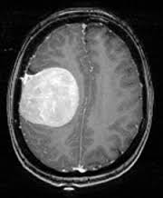
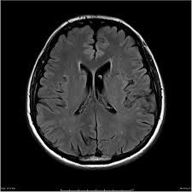
Data Source
The data source used for this project is a dataset that is publicly available on Kaggle
https://www.kaggle.com/navoneel/brain-mri-images-for-brain-tumor-detection
The dataset consists of a total of 253 images, with 155 images containing brain tumor and 98 images without brain tumor.
The images are in JPEG format and have a resolution of 256 x 256 pixels.
This dataset has been curated specifically for brain tumor detection and can be used to train and evaluate machine learning models for this purpose.

Slide 4
Steps Followed
Pre Processing
Neural Network
Make Predictions
Resizing the images to standard size
Converting all the images to RGB
Normalizing the pixel values to a specific range (0 to 1)
Make sure all images are consistent across dataset
Define the neural network architecture
Train the neural network
Evaluate the neural network
Once the neural network is trained, it can be used to make predictions on new, unseen MRI images.

Slide 5
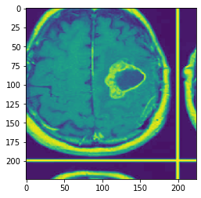
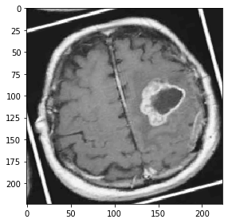
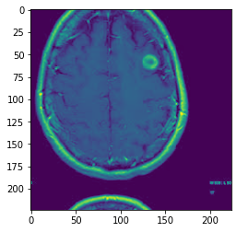
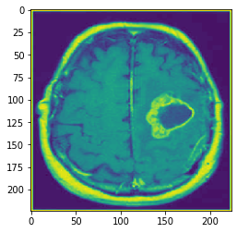
Data Augmentation
Rotation
Affine Transformation
Warp

Slide 6
Implementation

Slide 7
Fully Connected Network
first_linear= nn.Sequential(
nn.Flatten(),
nn.Linear(150528,hidden_nodes),
nn.LeakyReLU(),
nn.Linear(hidden_nodes,hidden_nodes),
nn.LeakyReLU(),
nn.Linear(hidden_nodes,2)
)

Slide 8
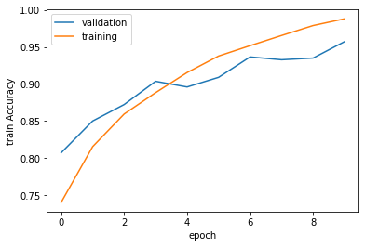
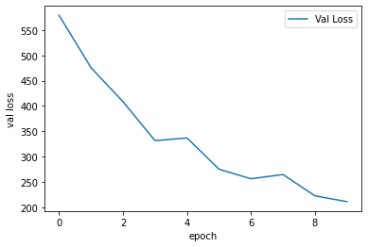
Fully Connected Network

Slide 9
Basic CNN
first_cnn= nn.Sequential(
nn.Conv2d(3,D,3,padding=1),
nn.ReLU(),
nn.Conv2d(32,1,(3),padding=1),
nn.ReLU(),
Flatten(),
nn.Linear(224*224,2),
)

Slide 10
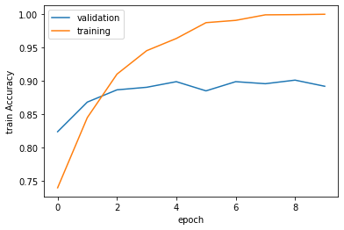
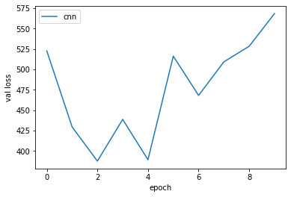
Basic CNN

Slide 11
CNN with Batch Normalization
second_cnn= nn.Sequential(
nn.Conv2d(3,D,3,padding=1),
nn.ReLU(),
nn.BatchNorm2d(D),
nn.Conv2d(32,32,(3),padding=1),
nn.ReLU(),
nn.BatchNorm2d(32),
nn.Conv2d(32,32,(3),padding=1),
nn.ReLU(),
nn.BatchNorm2d(32),
nn.Conv2d(32,32,(3),padding=1),
nn.ReLU(),
nn.BatchNorm2d(32),
Flatten(),
nn.Linear(1605632,2),
)

Slide 12
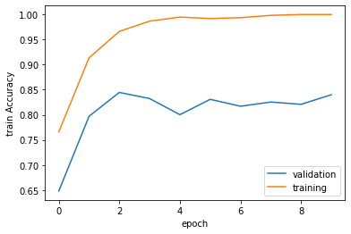
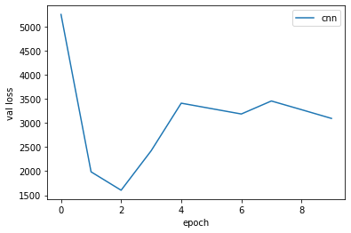
CNN with Batch Normalization

Slide 13
CNN with Layer Norm
third_cnn= nn.Sequential(
nn.Conv2d(3,D,3,padding=1),
nn.ReLU(),
nn.LayerNorm(width_height),
nn.Conv2d(32,32,(3),padding=1),
nn.ReLU(),
nn.LayerNorm(width_height),
nn.Conv2d(32,32,(3),padding=1),
nn.ReLU(),
nn.LayerNorm(width_height),
nn.Conv2d(32,32,(3),padding=1),
nn.ReLU(),
nn.LayerNorm(width_height),
nn.Flatten(),
nn.Linear(1605632,2),
)

Slide 14
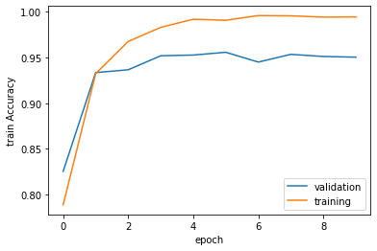
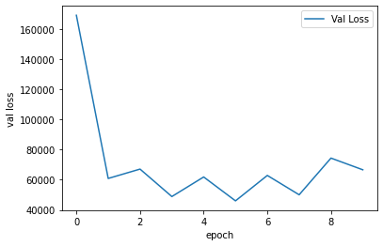
CNN with Layer Norm

Slide 15
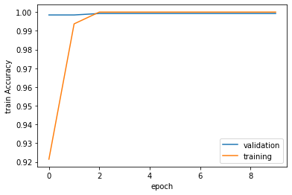
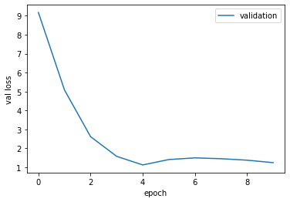
Vgg 16

Slide 16
Conclusion
Although the models we designed performed well, the pre-trained model out-performed them. The constant and surging accuracy can possibly be attributed to the size of our dataset. This was a good learning experience that enlightened us to newer and efficient techniques. An extension of this project could be using unlabeled data and trying to learn features to detect tumor.

Slide 17
Thank You!
Questions???

